Slide 1
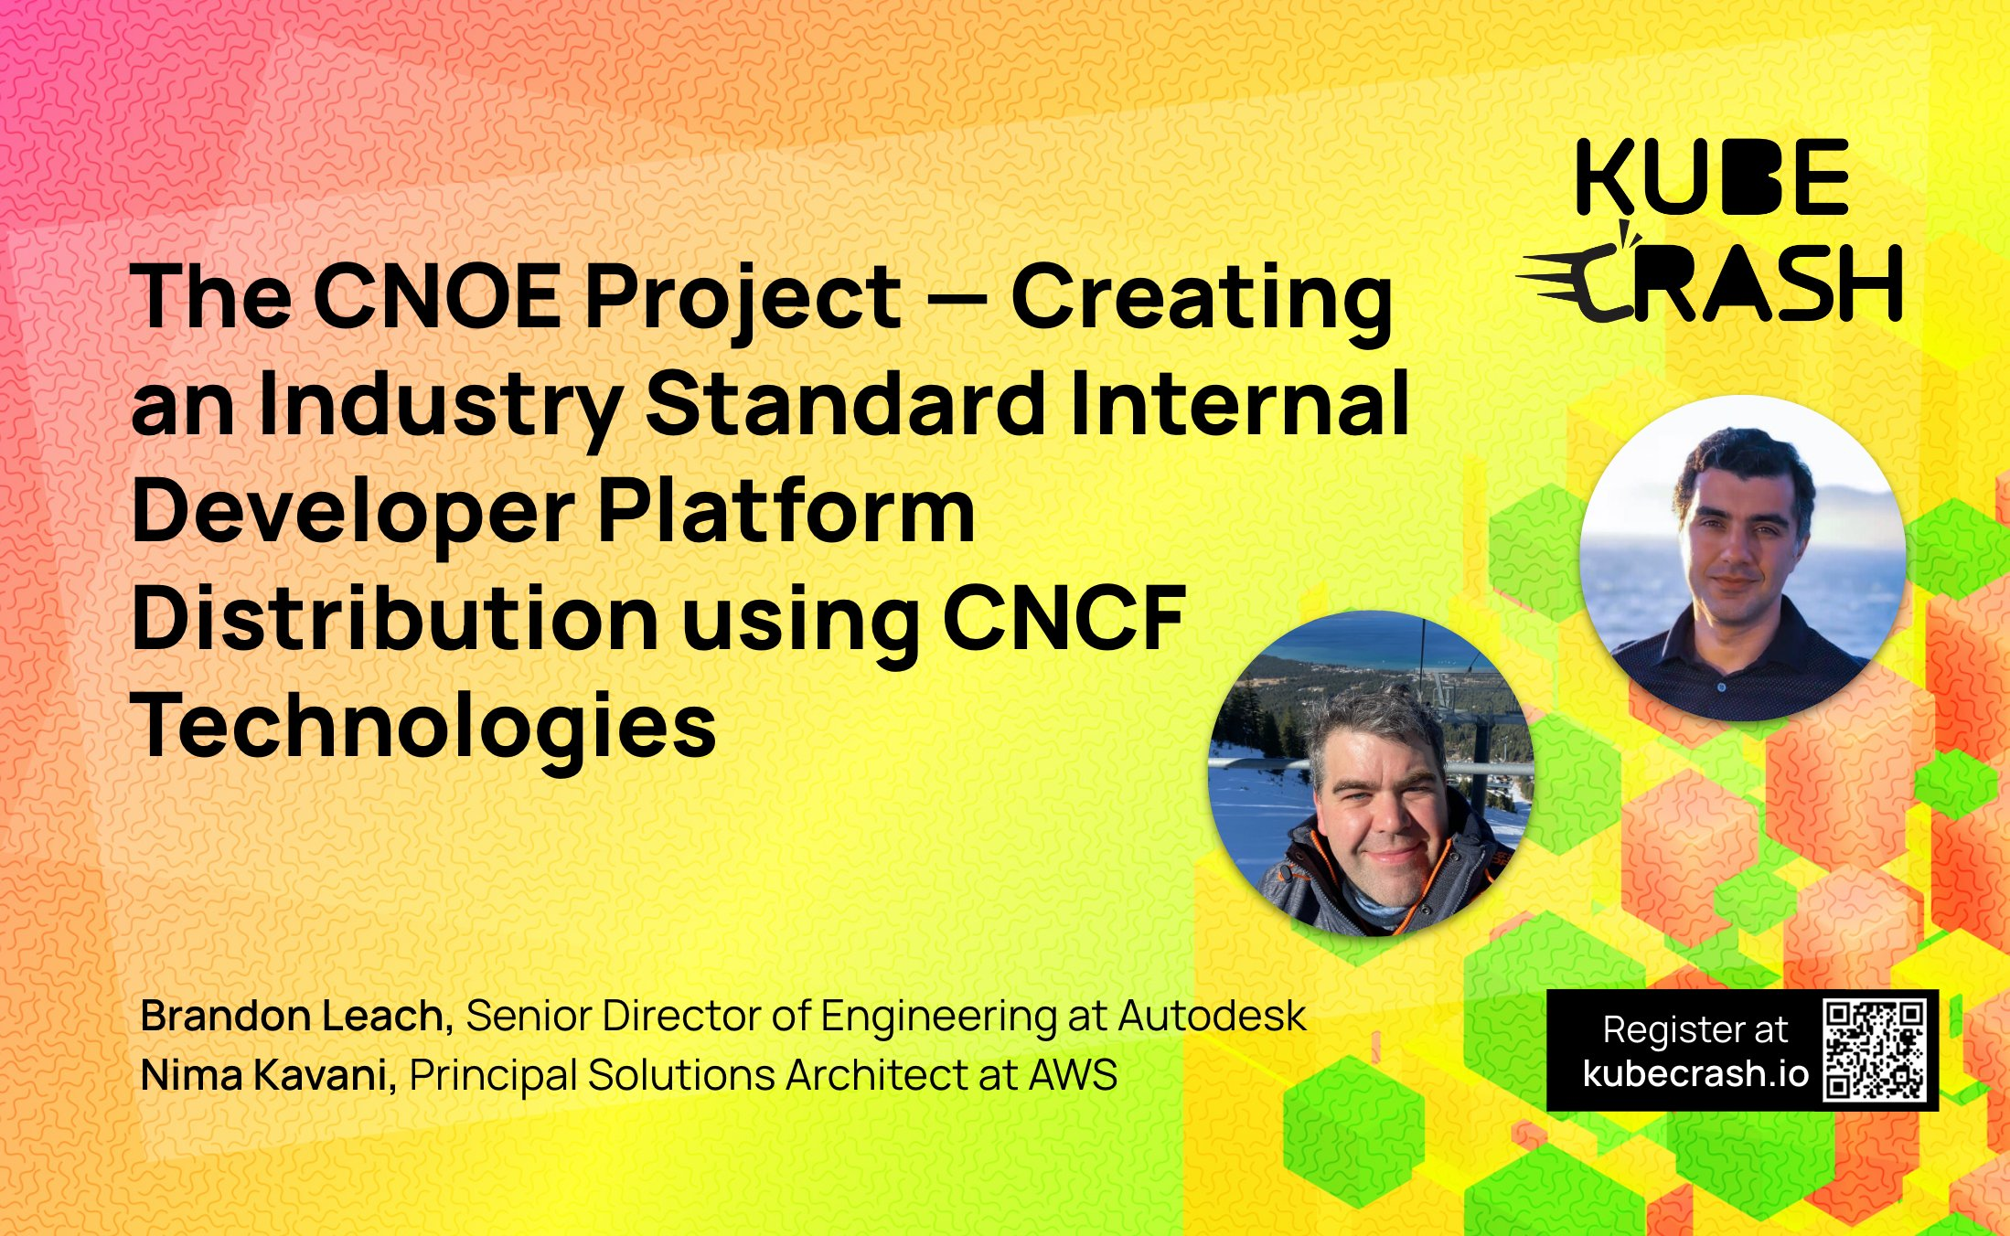


Slide 2
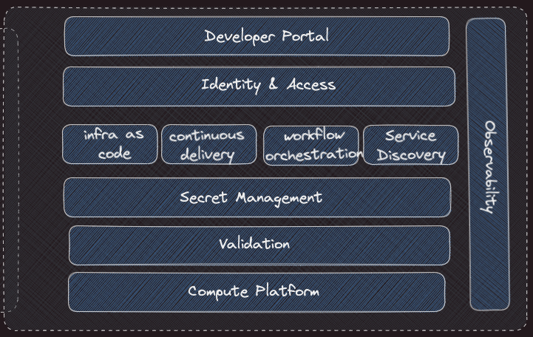
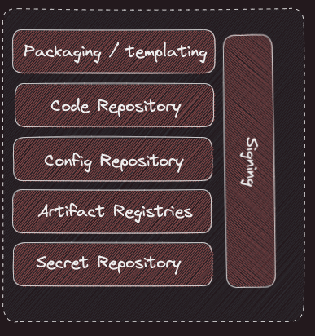
Internal Developer Platform - Capabilities

Slide 3
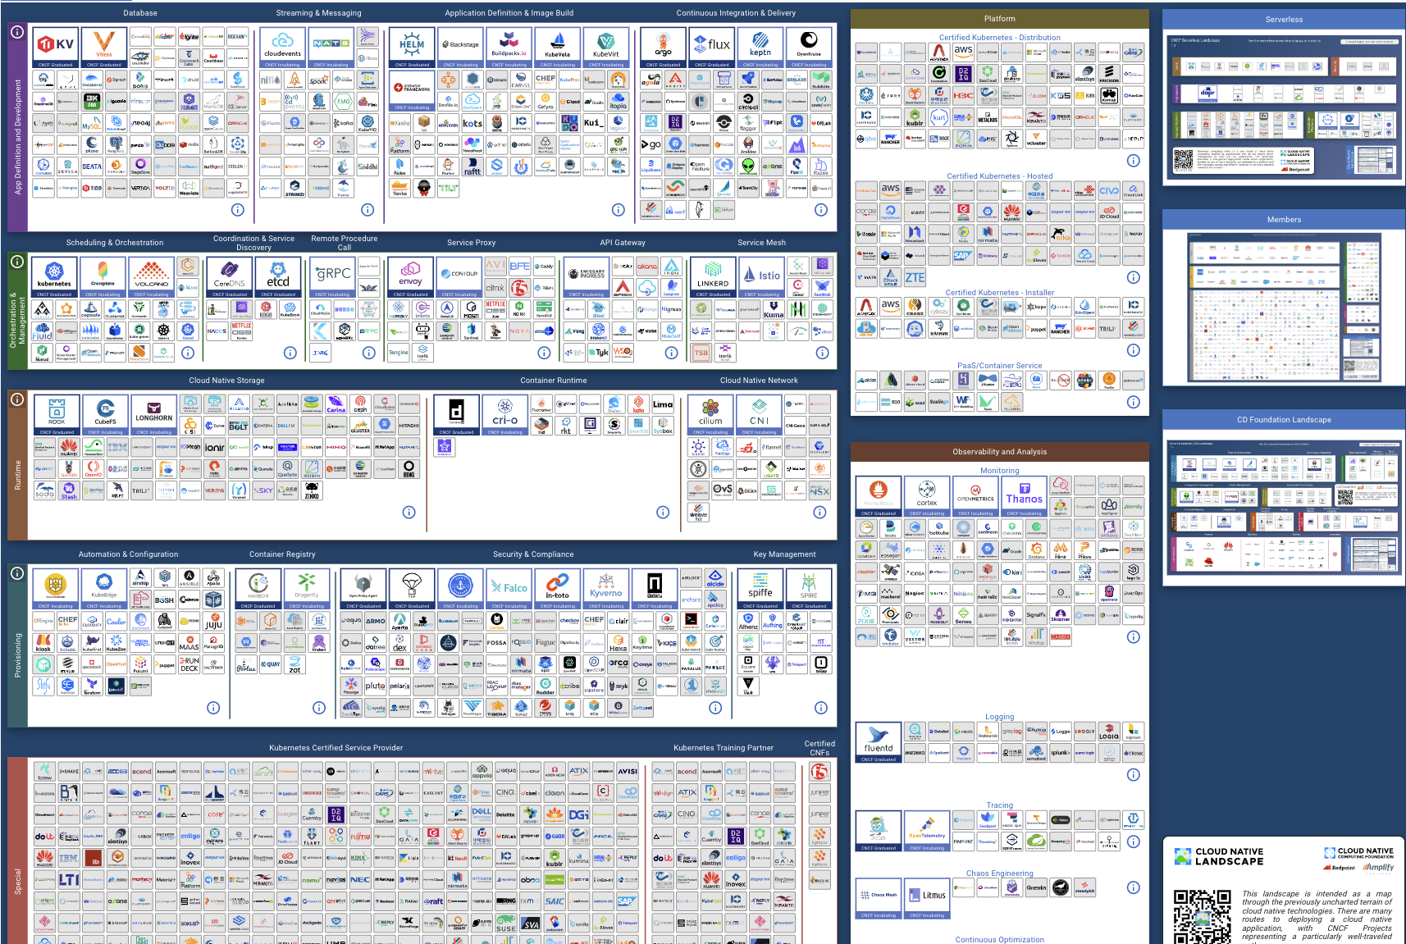

Slide 4

Have you seen a
Solution?

Slide 5





The Platforming Journey
Choose the Stack
Build the Stack
Test the Stack
Sell the Stack
Scale the Stack

Slide 6
Choosing the
Stack

Slide 7
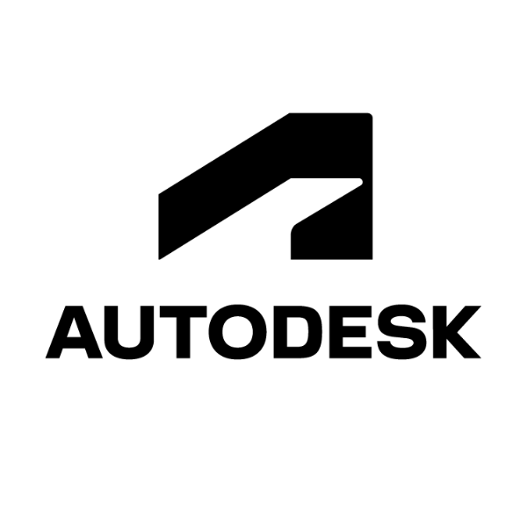





Scale of Operation

Slide 8
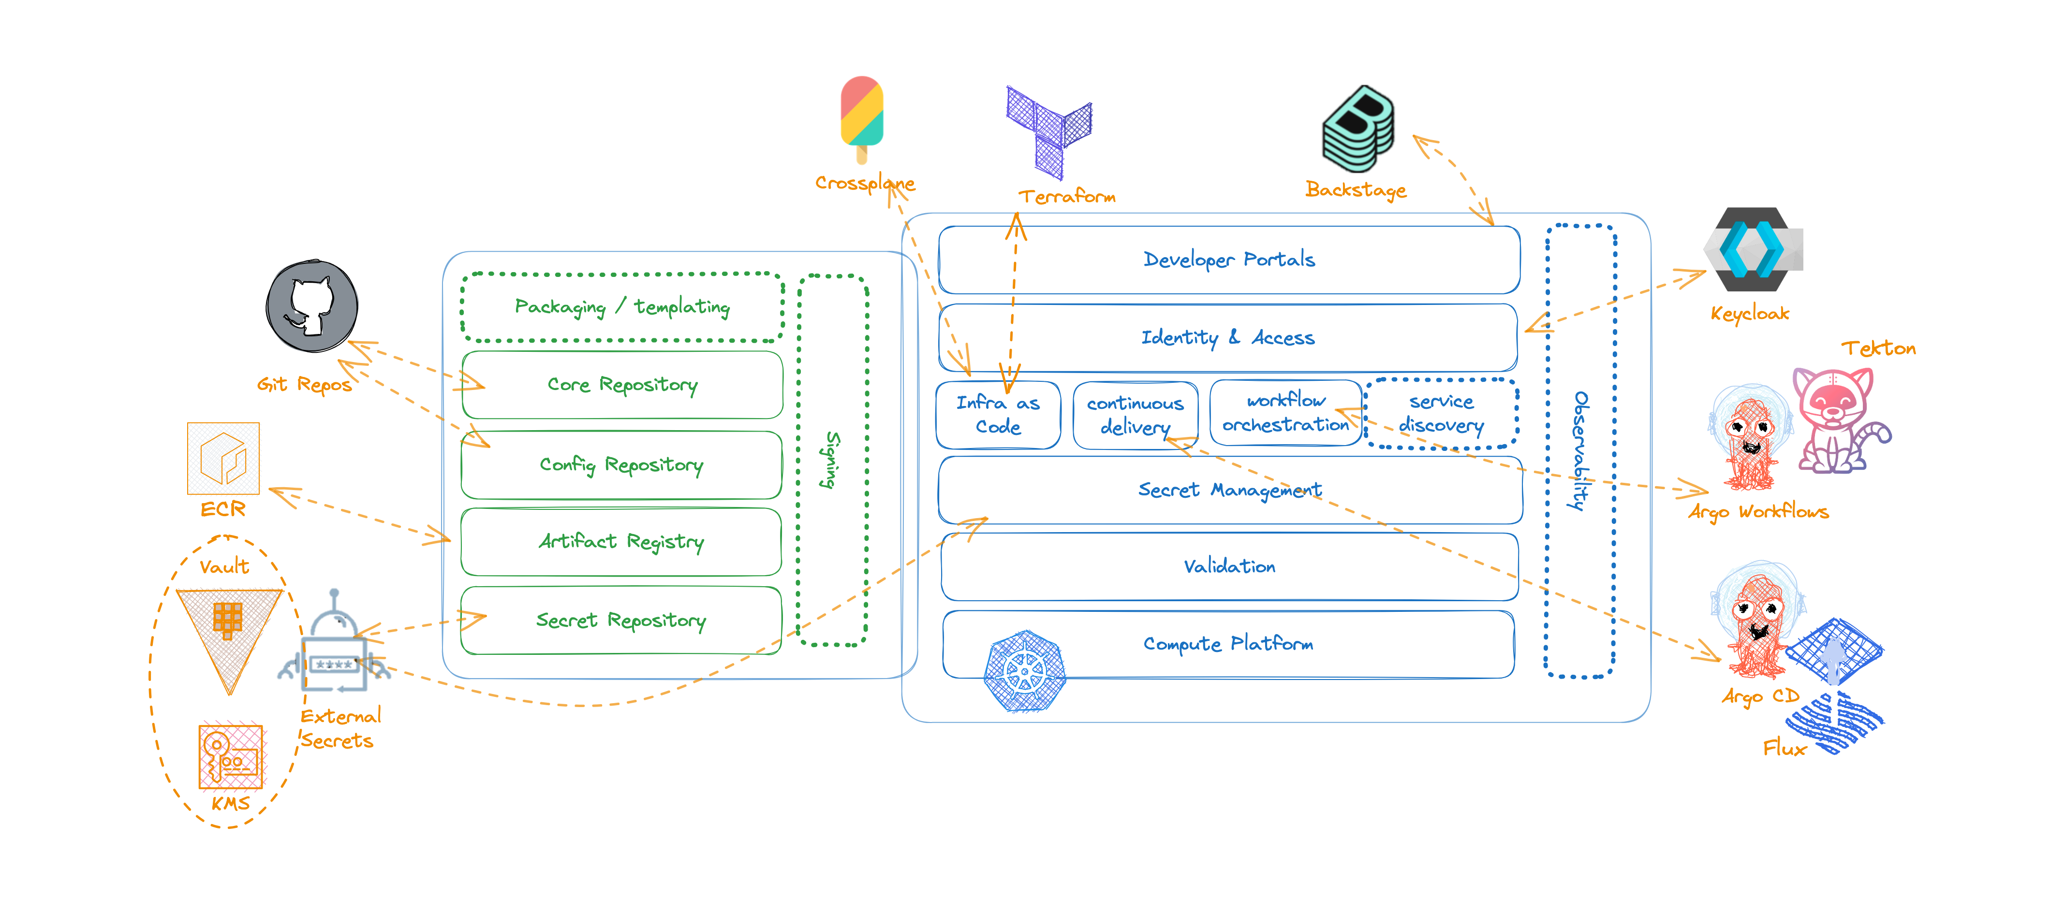
Reduced Technology Choices
Notes:
It is not supposed to be a one size fits all type of solution
We have built modular bits that can be taken and composed at every companies own discretion
Through the collaboration, you will have a wealth of expertise for like minded experts in the space to bounce ideas off of
At the same time, integration with the internals of your own IDPs at your own company is a responsibility that you will assume yourself

Slide 9
CNOE is an internal developer platform (IDP) distribution built in the open with the goal to help with delivering a platform

Slide 10


A Linux distro
An IDP Distribution
is an operating system made from a software collection that is based upon the Linux kernel and, often, a package management system.
is a developer platform made from a software collection that is based upon Kubernetes, as well as a package management system.

Slide 11
Building the Stack

Slide 12
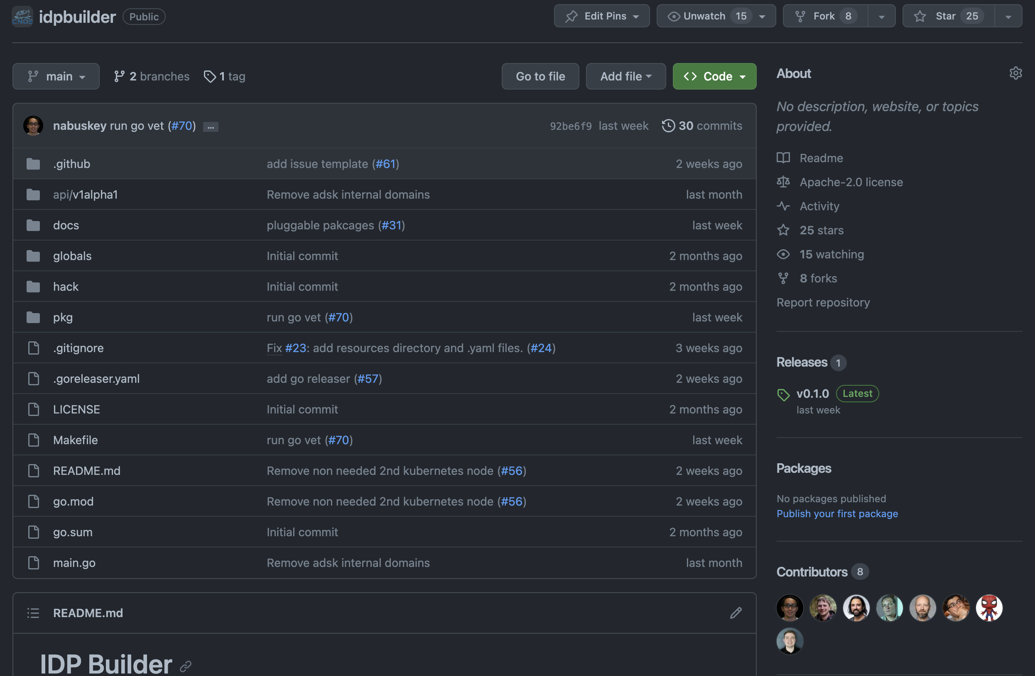
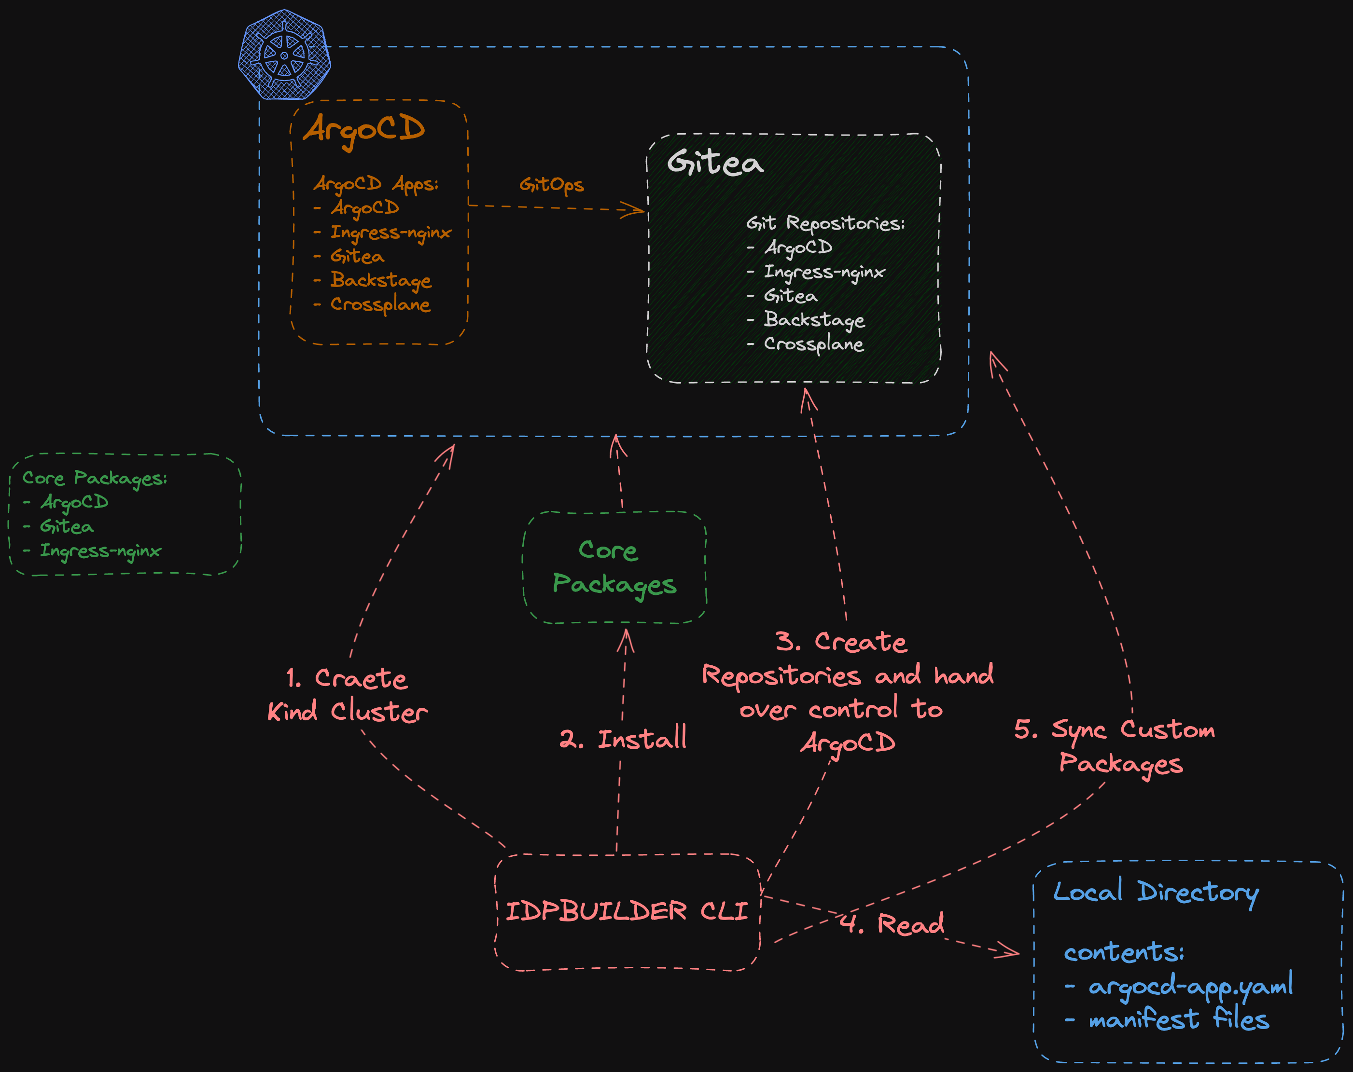
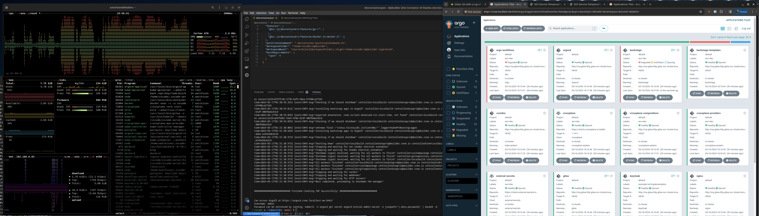
idpBuilder
github.com/cnoe-io/idpbuilder

Slide 13
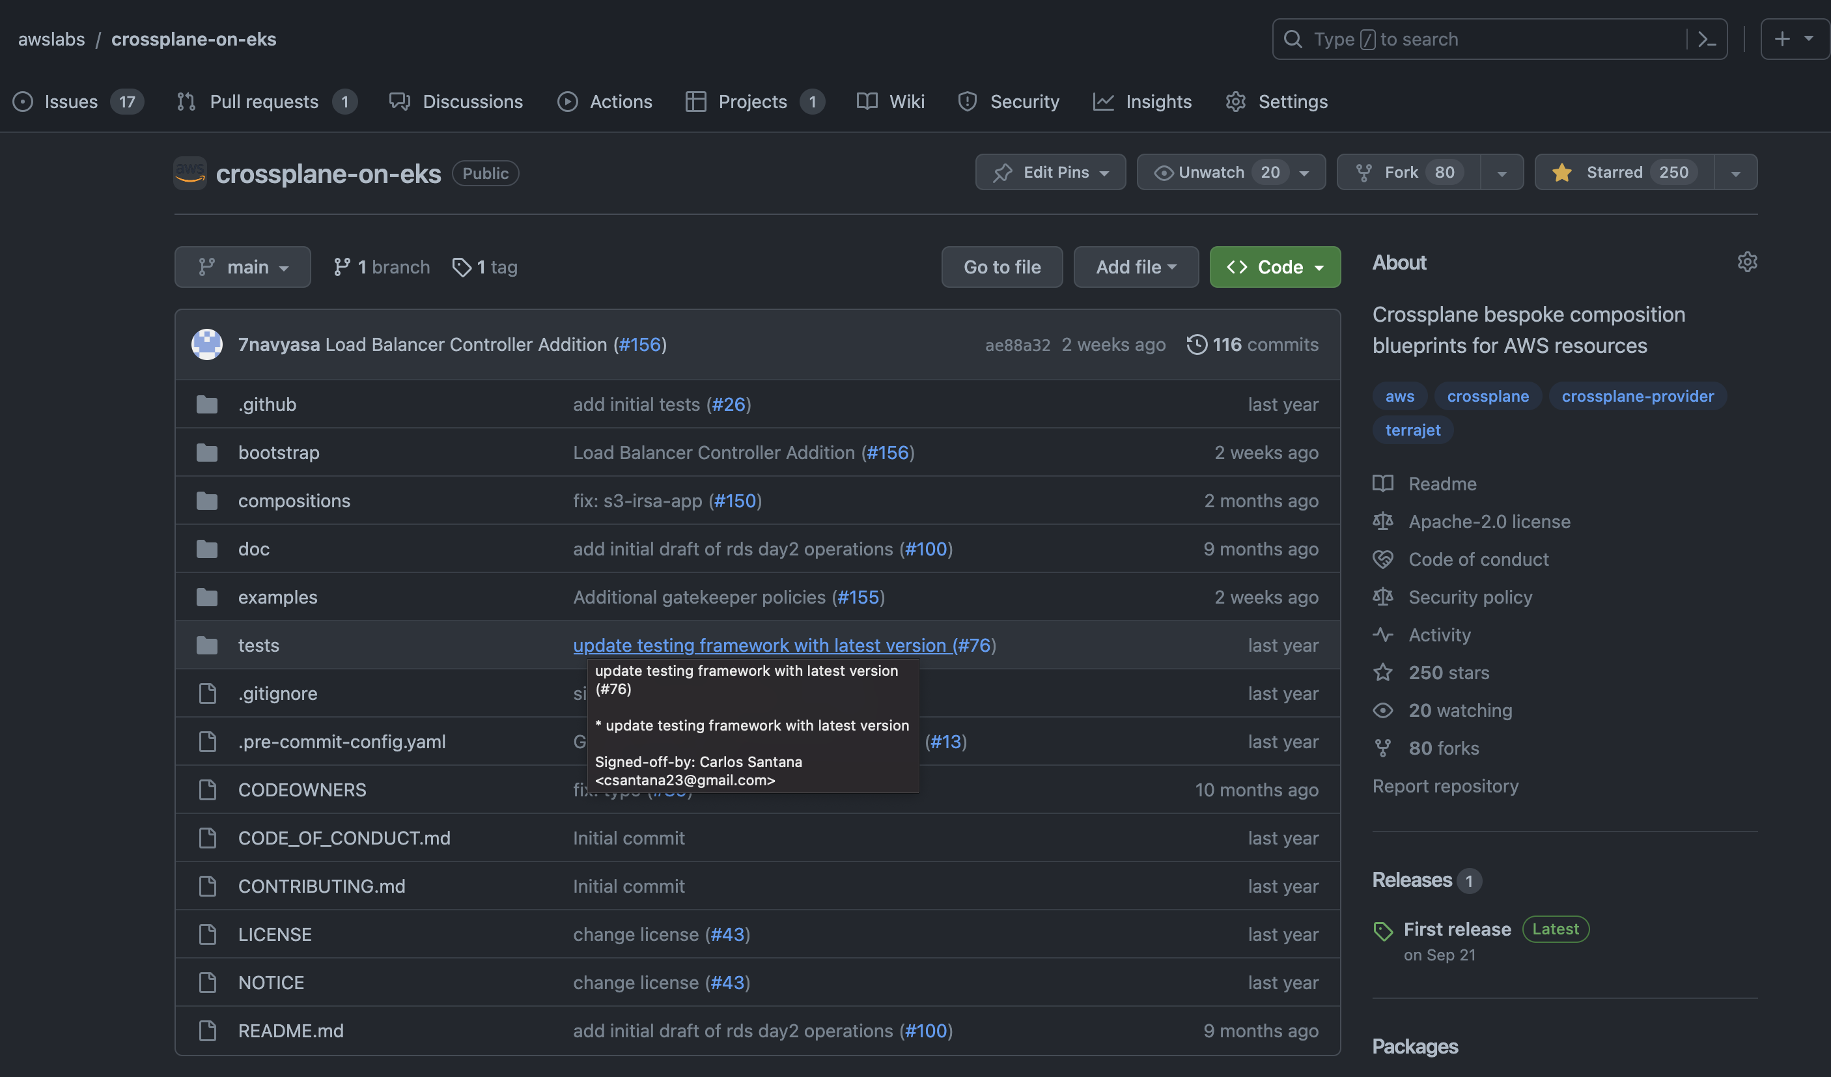
Crossplane Patterns
https://github.com/awslabs/crossplane-on-eks

Slide 14
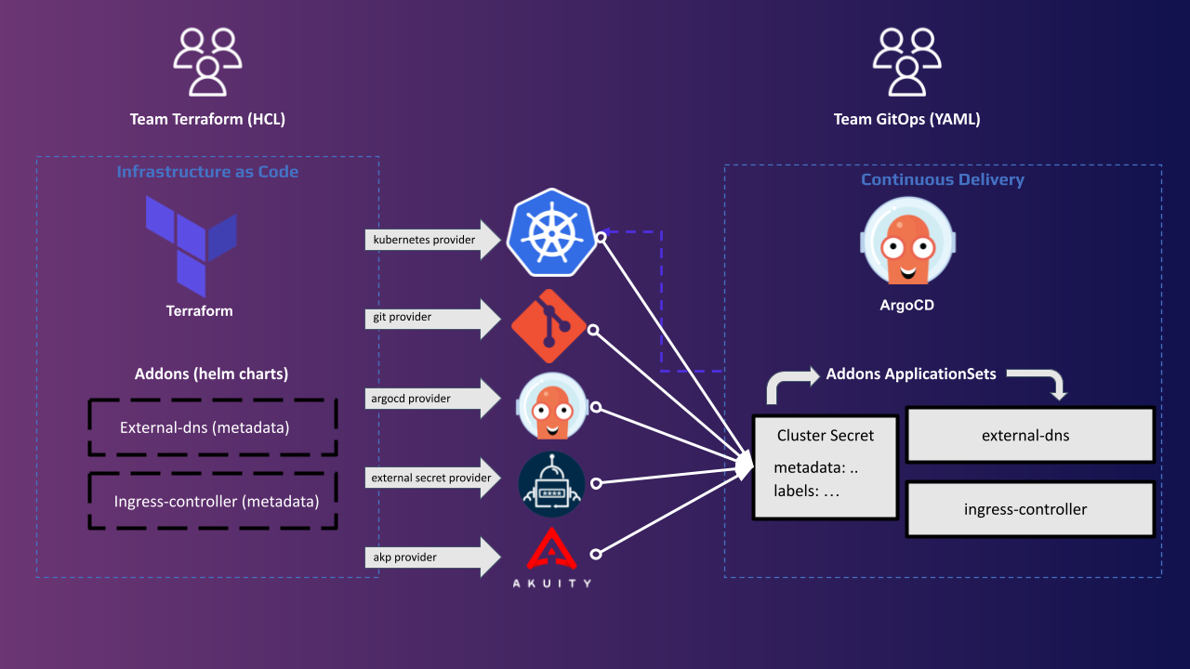
GitOps Bridge
https://github.com/gitops-bridge-dev

Slide 15
Testing the Stack

Slide 16




idpBuilder Execution Platforms
GitHub Codespaces
Loft Lab DevPods
Amazon Cloud9
CI/CD containers

Slide 17
Selling
the Stack

Slide 18
Who is using it / How is using it?

Slide 19
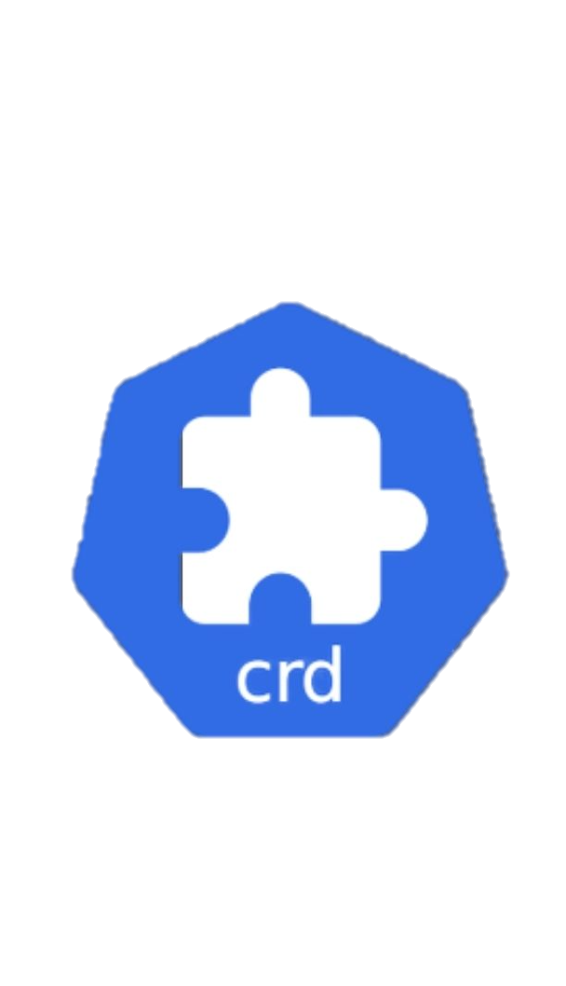
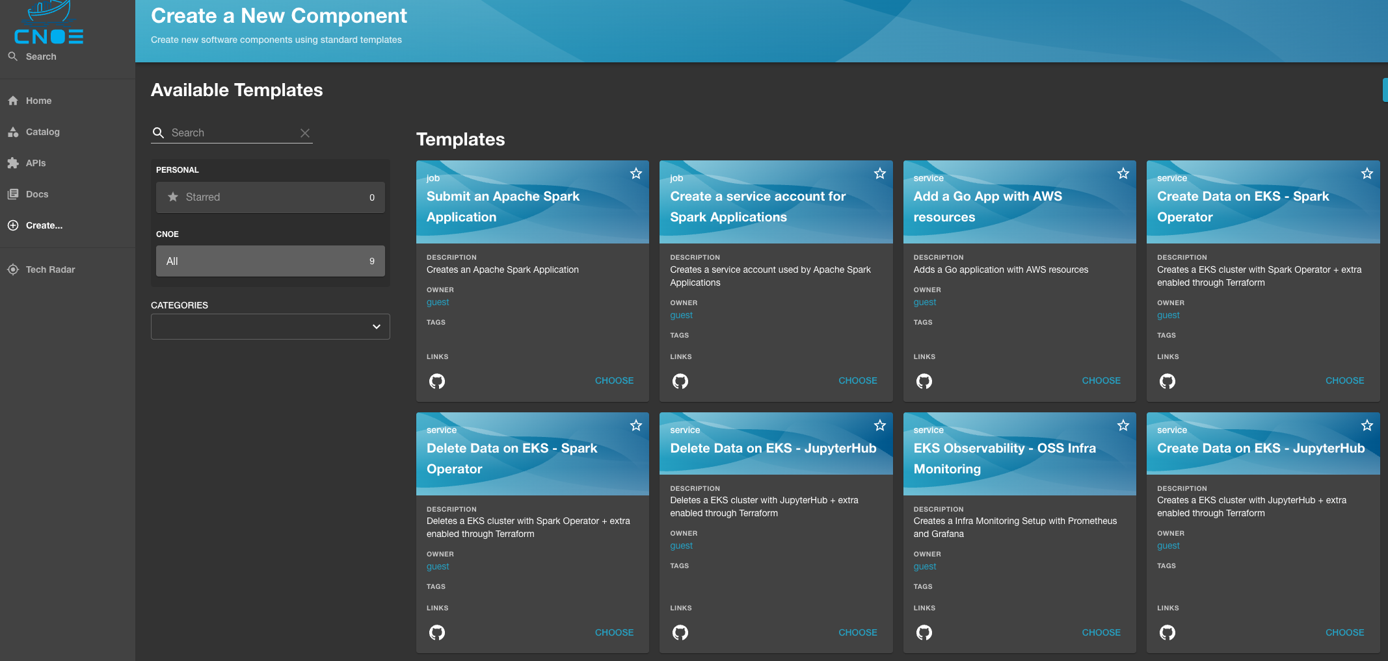


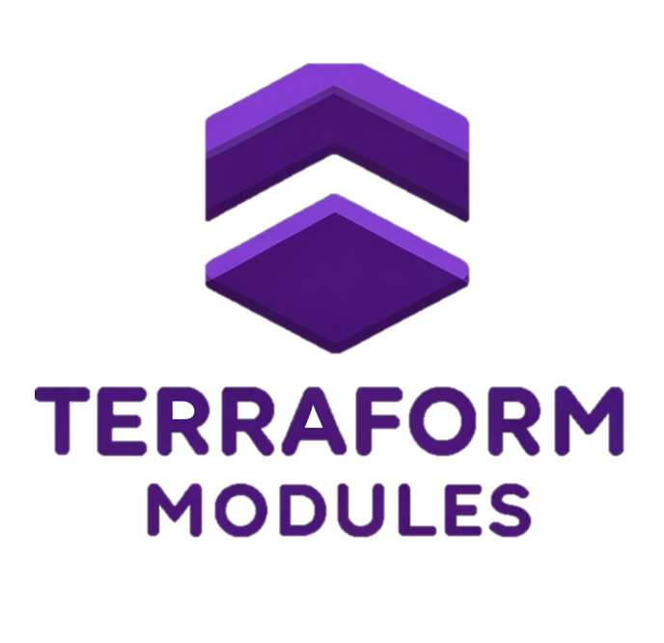
CNOE CLI
github.com/cnoe-io/cnoe-cli

Slide 20
CNOE CLI
github.com/cnoe-io/cnoe-cli

Slide 21
Scaling
the Stack

Slide 22

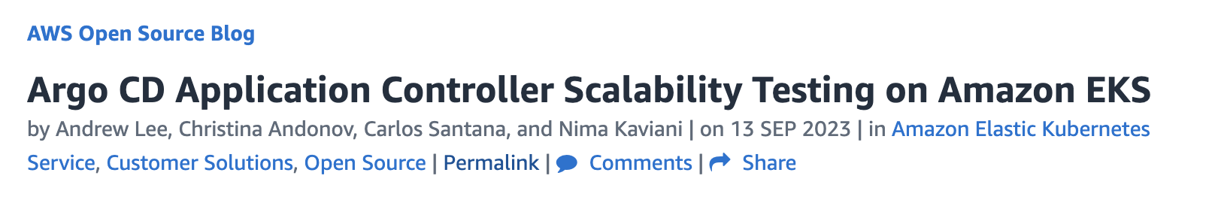
Scalability Work
10,000 Argo CD Applications
100 Clusters
Performance Improvements
Configuration Tuning
Part 1: http://bit.ly/3QtFnM5

Slide 23
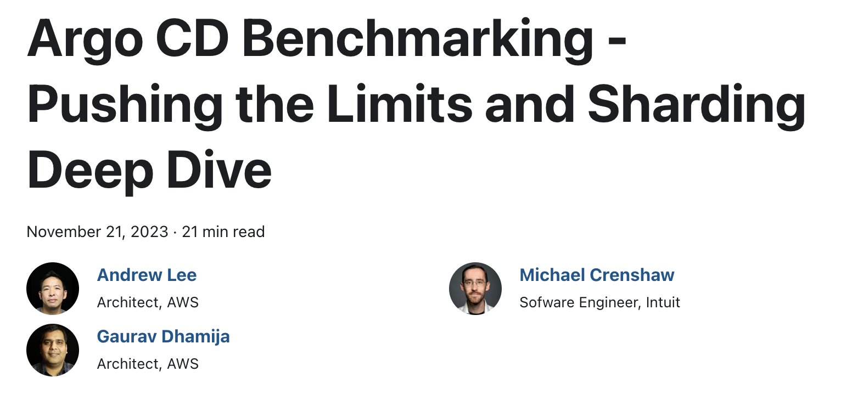
Scalability Work
50,000 Argo CD Applications
5,000 Clusters
Performance Improvements
New Sharding Algorithms
Configuration Tuning
Argo Workflows Scalability
Backstage Auth Mechanism
Part 2: https://cnoe.io/blog/argo-cd-application-scalability

Slide 24

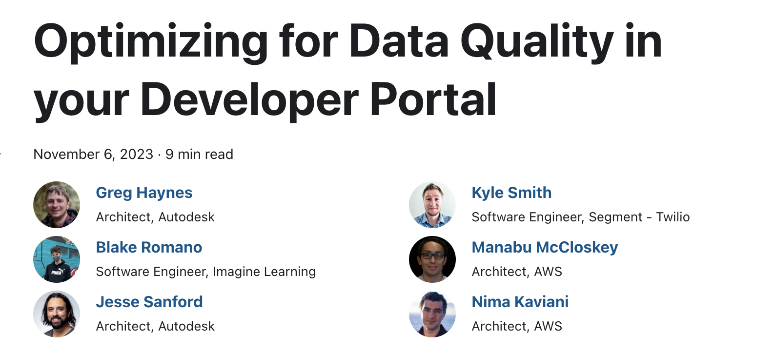
Developer Portal Best Practices
Backstage plugins
Developer practices
https://cnoe.io/blog/optimizing-data-quality-in-dev-portals

Slide 25
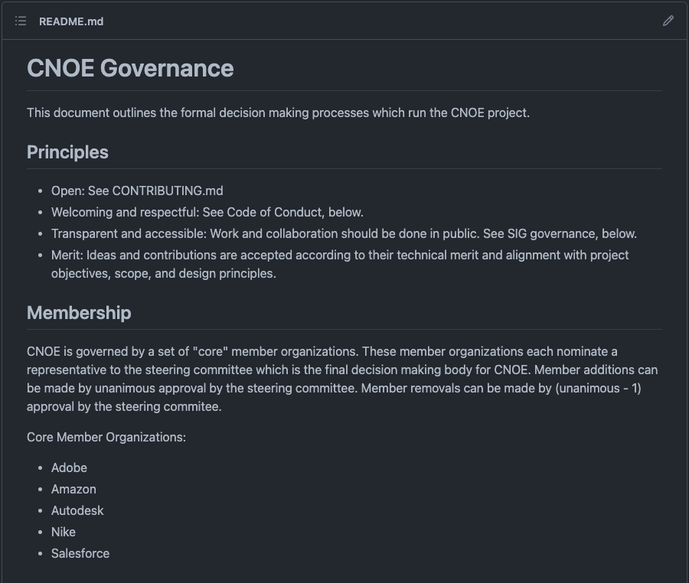
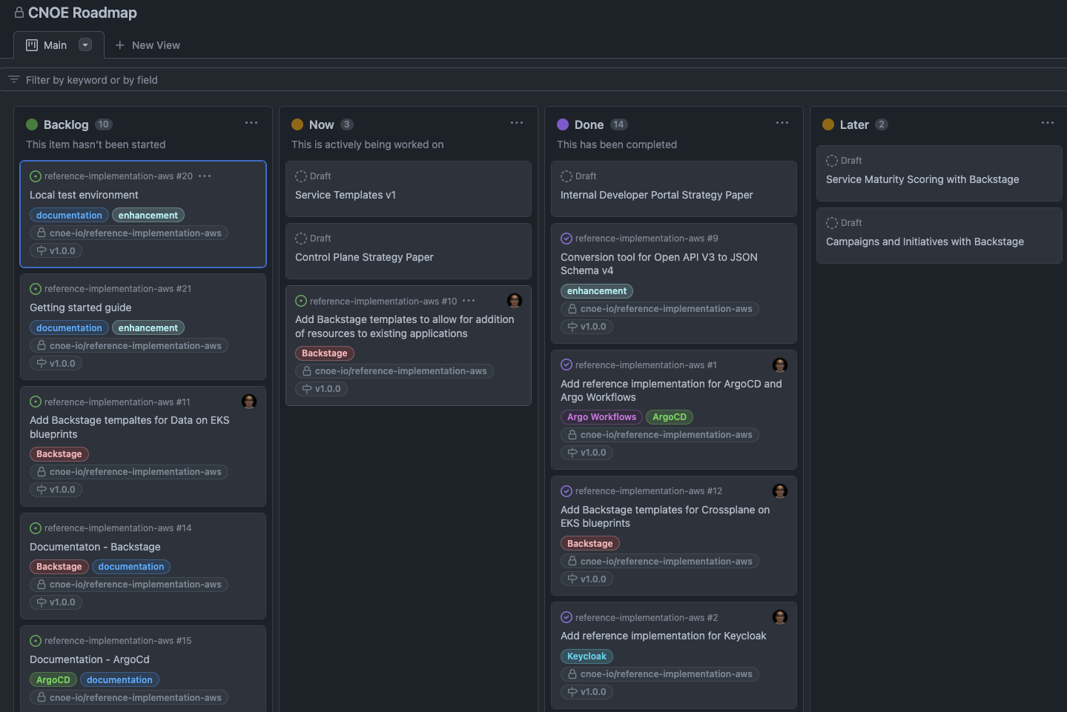
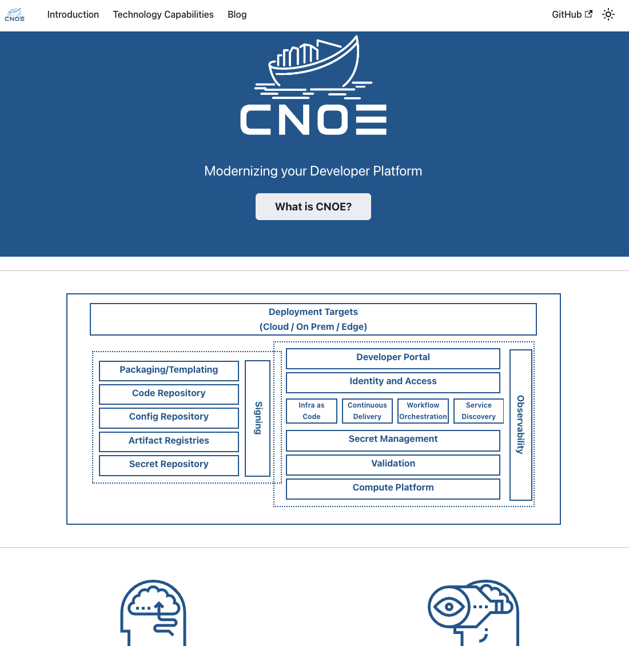
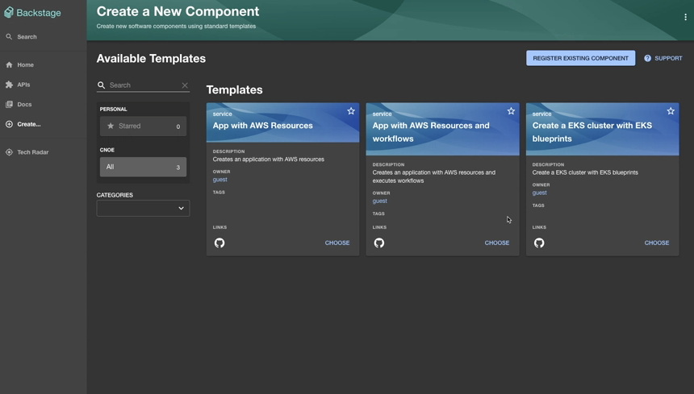
How is CNOE progressing?
The Governance Model
Project Roadmap
https://cnoe.io
#cnoe-interest on CNCF slack

Slide 26
Thank you
Nima Kaviani
Frank Carta
nkaviani@amazon.com
fcarta@amazon.com

